Slide 1

P peline
The Data
Infrastructure Issues and Big Data
© Jennifer Mankoff
The Data Pipeline; HCII; Spring 2014

Slide 2
Goals for today
Review of difficult concepts from last lecture
Discuss Visualization for Big Data
Talk about Byte 6

Slide 3
Closed World Assumption
Presumes all true statements are known
Observer can thus make inferences about new things: if they are not known, they are false

Slide 4
Open World Assumption
No single observer has complete information
Observer can only make inferences about things that derive from things it already know to be true
represent information as we discover it and cannot guarantee that we know everything true
statements depending on unknown features are unknown rather than false

Slide 5
Example:
Statement: Jane is on the plane
Question: Is Paul on the plane?

Slide 6
Example:
Statement: Jane is on the plane
Question: Is Paul on the plane?
OWA: Unknown
CWA: No!

Slide 7
Example: Decision Trees
Contain statements about how features relate to outcomes
Question: What happens when an attribute is included that is not in the tree?
Notes:
Answer: Use the attributes you have and then use the majority class to decide …

Slide 8
Example: Naïve Bayes
Contain statements about how features relate to outcomes
Question: What happens when an attribute is included that is not in the tree (or is missing)?
Notes:
Answer: makes assumptions about things being ‘false’ [if not known]

Slide 9
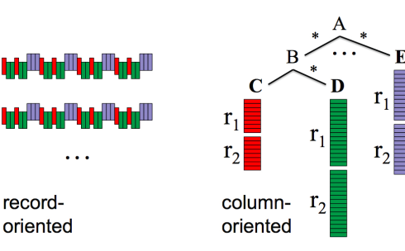
What makes Big Query so fast?
https://cloud.google.com/files/BigQueryTechnicalWP.pdf
Notes:
Based on Dremel: ‘it separates a record into column values and stores each value on different storage volume’
‘For example, a query “SELECT top(title) FROM foo” would access the title column values only. In case of the Wikipedia table example, the query would scan only 9.13GB out of 35.7GB.’
‘Higher compression ratio. One study reports that columnar storage can achieve a compression ratio of 1:10, whereas ordinary row-based storage can compress at roughly 1:3. ‘

Slide 10
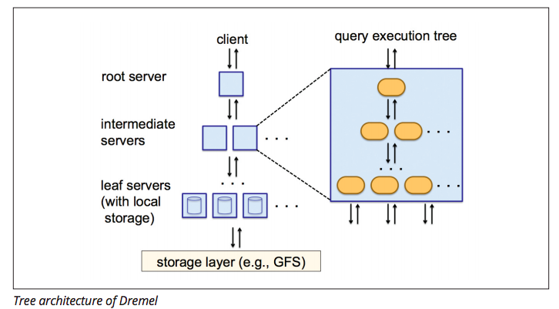
What makes Big Query so fast?
https://cloud.google.com/files/BigQueryTechnicalWP.pdf
Notes:
by using a Binary Tree, the data is sharded across multiple machines. This helps retrieve data much faster (interactive vs batch processing speeds)
Makes it hard to update things (thus append only)

Slide 11
What makes it slow on Byte 6?
https://cloud.google.com/files/BigQueryTechnicalWP.pdf
It is not ideal for stochastic gradient descent
Would be better to use map reduce for training, bigquery for running the model
It is great for summarizing (supports visualization well)
Also good for trial and error analysis
Notes:
by using a Binary Tree, the data is sharded across multiple machines. This helps retrieve data much faster (interactive vs batch processing speeds)
Makes it hard to update things (thus append only)

Slide 12
Sampling from Streams
Example: Want to ask question of a subset of data and have them be representative of the whole stream
http://www.aaai.org/ocs/index.php/ICWSM/ICWSM13/paper/viewFile/6071/6379
infolab.stanford.edu/~ullman/mmds/ch4.pdf
www.kdd.org/kdd2014/tutorials/t10_part1.pptx

Slide 13
Sampling from Streams
Example: Want to ask question of a subset of data and have them be representative of the whole stream
Could sample 1 of every n elements
Can also sample based on priority, weights, etc.
http://www.aaai.org/ocs/index.php/ICWSM/ICWSM13/paper/viewFile/6071/6379
infolab.stanford.edu/~ullman/mmds/ch4.pdf
www.kdd.org/kdd2014/tutorials/t10_part1.pptx

Slide 14
Sampling from Streams
Example: Want to ask question of a subset of data and have them be representative of the whole stream
Example: Count-distinct elements (e.g. Which pages are getting an unusual number of hits this hour?)
http://www.aaai.org/ocs/index.php/ICWSM/ICWSM13/paper/viewFile/6071/6379
infolab.stanford.edu/~ullman/mmds/ch4.pdf
www.kdd.org/kdd2014/tutorials/t10_part1.pptx

Slide 15
Sampling from Streams
Example: Want to ask question of a subset of data and have them be representative of the whole stream
Example: Count-distinct elements (e.g. Which pages are getting an unusual number of hits this hour?)
Example: Analyzing things that meet a criterion (filtering)

Slide 16
Visualizing Big Data
First a tour
Then some techniques
http://www.smashingmagazine.com/2007/08/02/data-visualization-modern-approaches

Slide 17
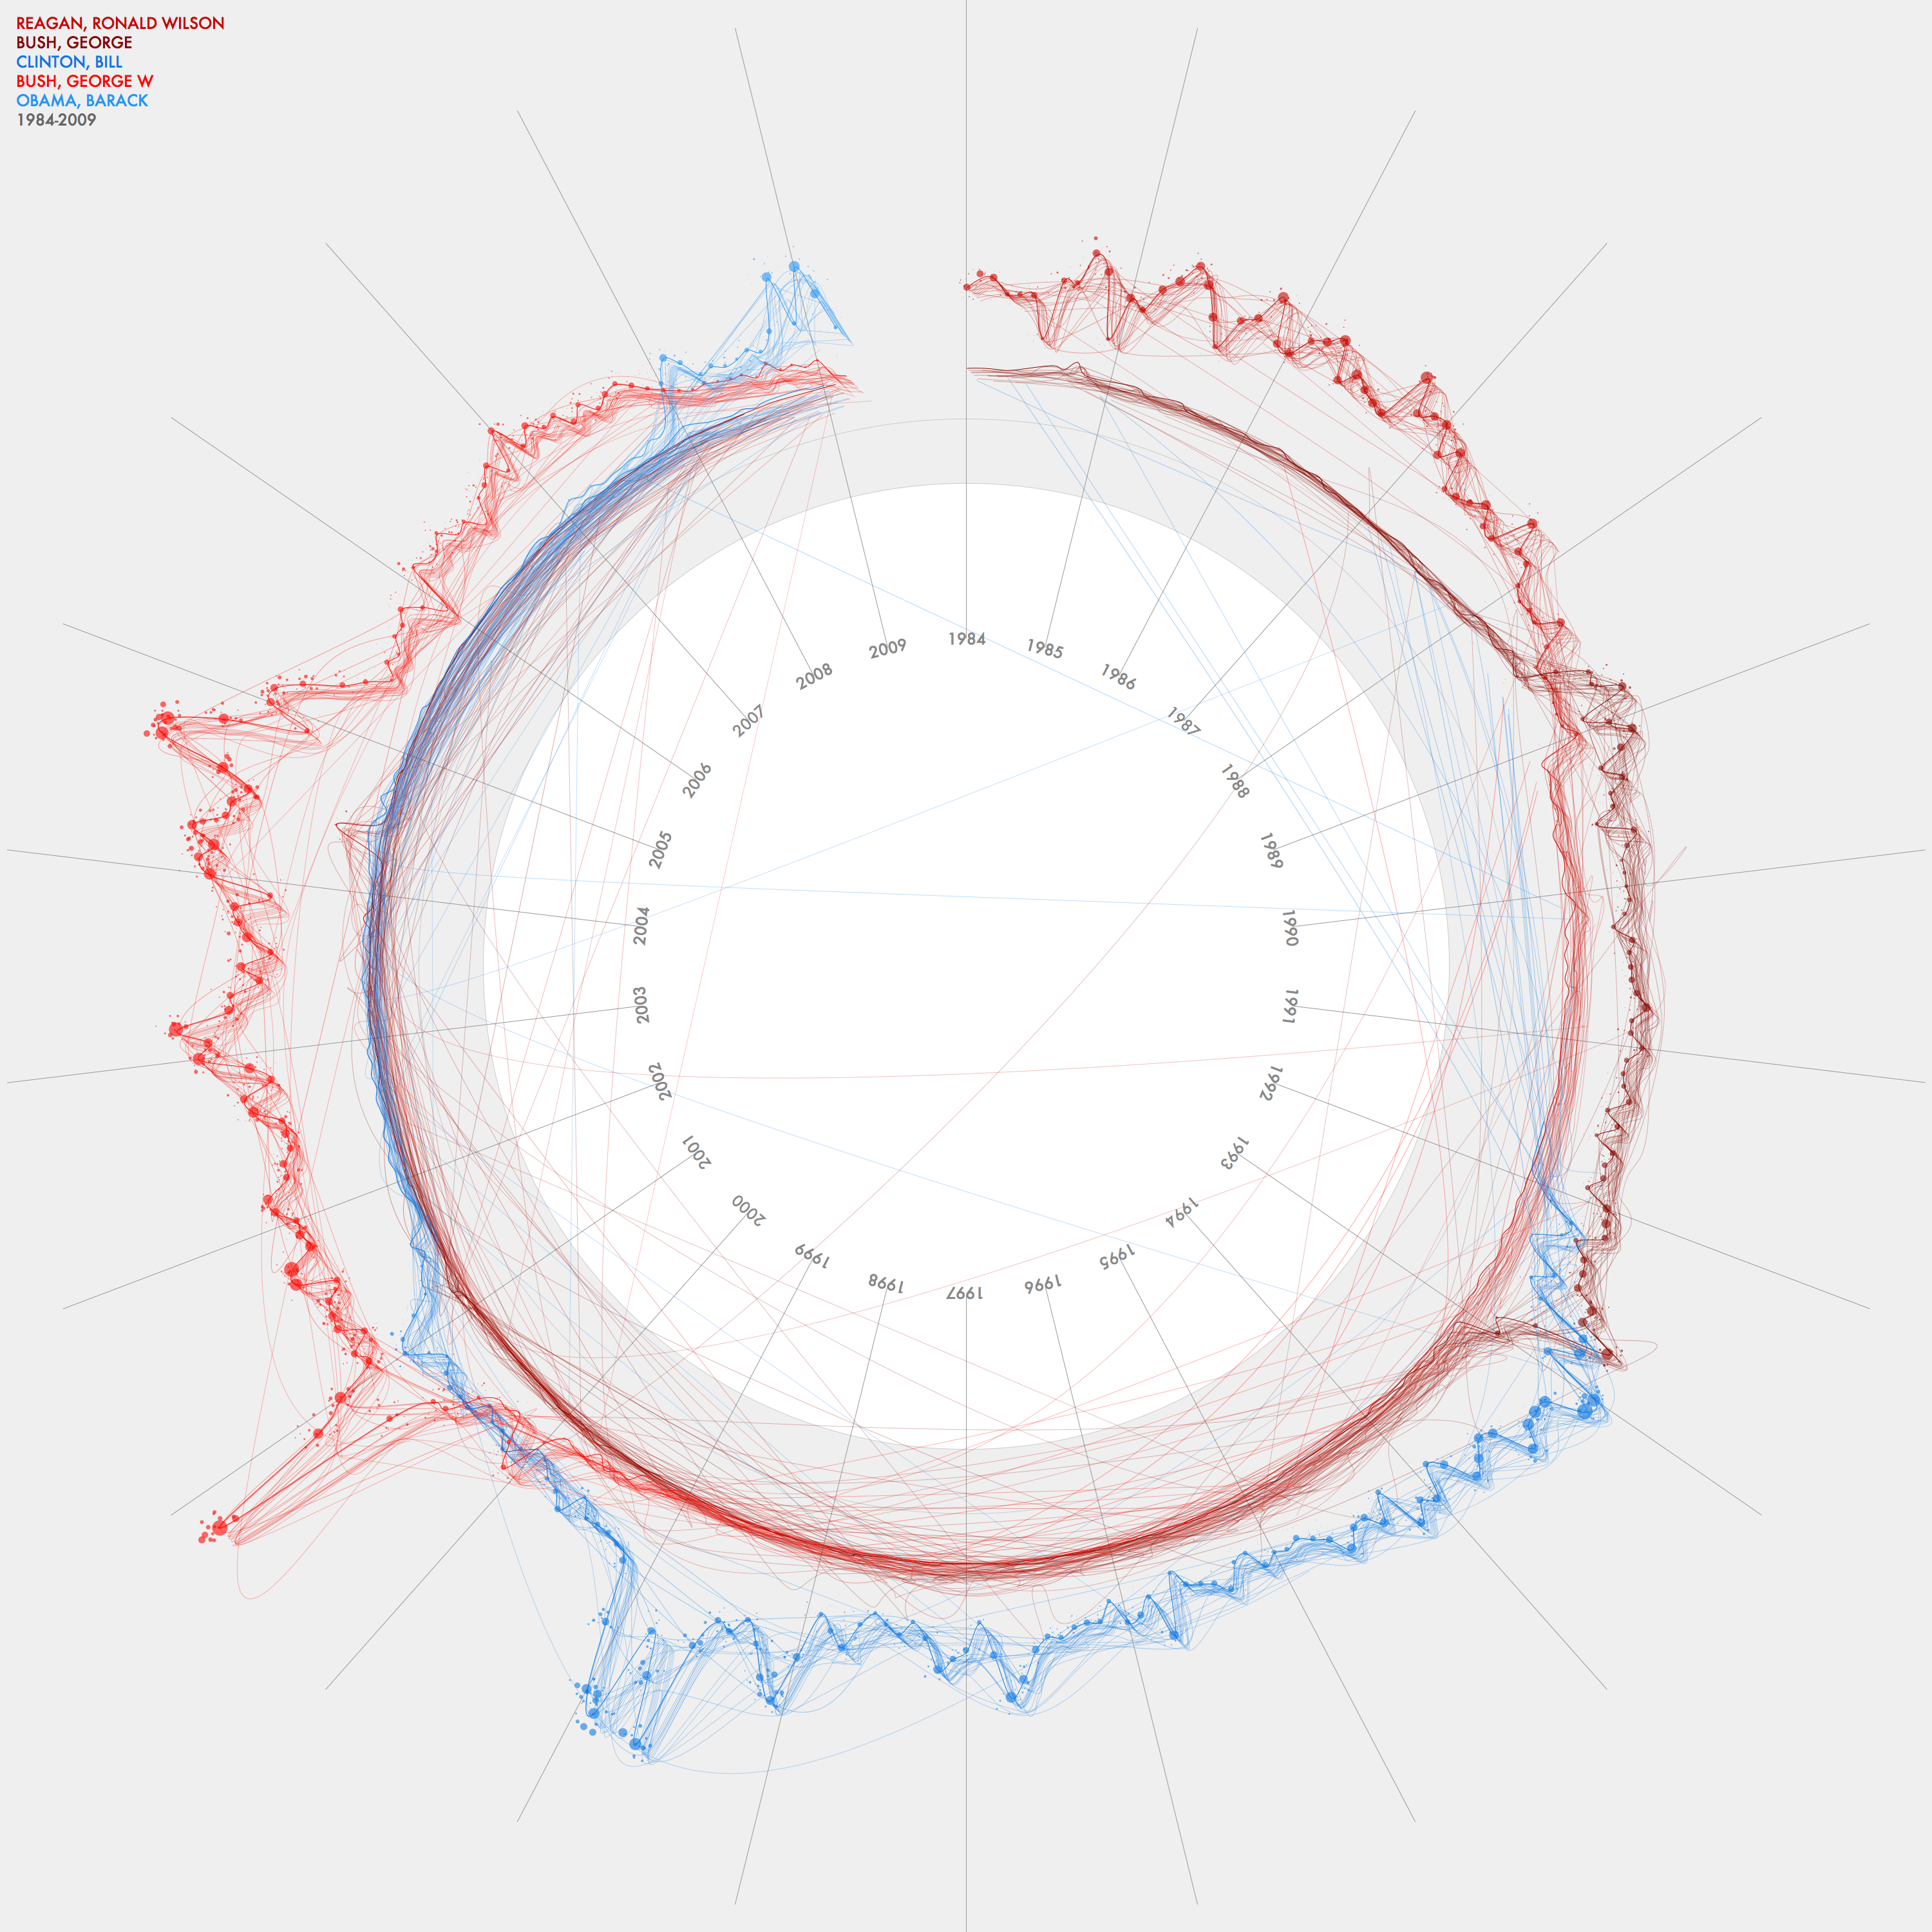
Jer Thorp
Data Artist
This graph charts the frequency of mention of the five US Presidents between 1984 and 2009. It also indicates weighting of stories - the darkest line shows front page stories while the lighter lines indicate stories buried deeper in the paper.
Built with Processing, v. 1.0
For more information about this and other newspaper visualizations, visit my blog: blog.blprnt.com

Slide 18
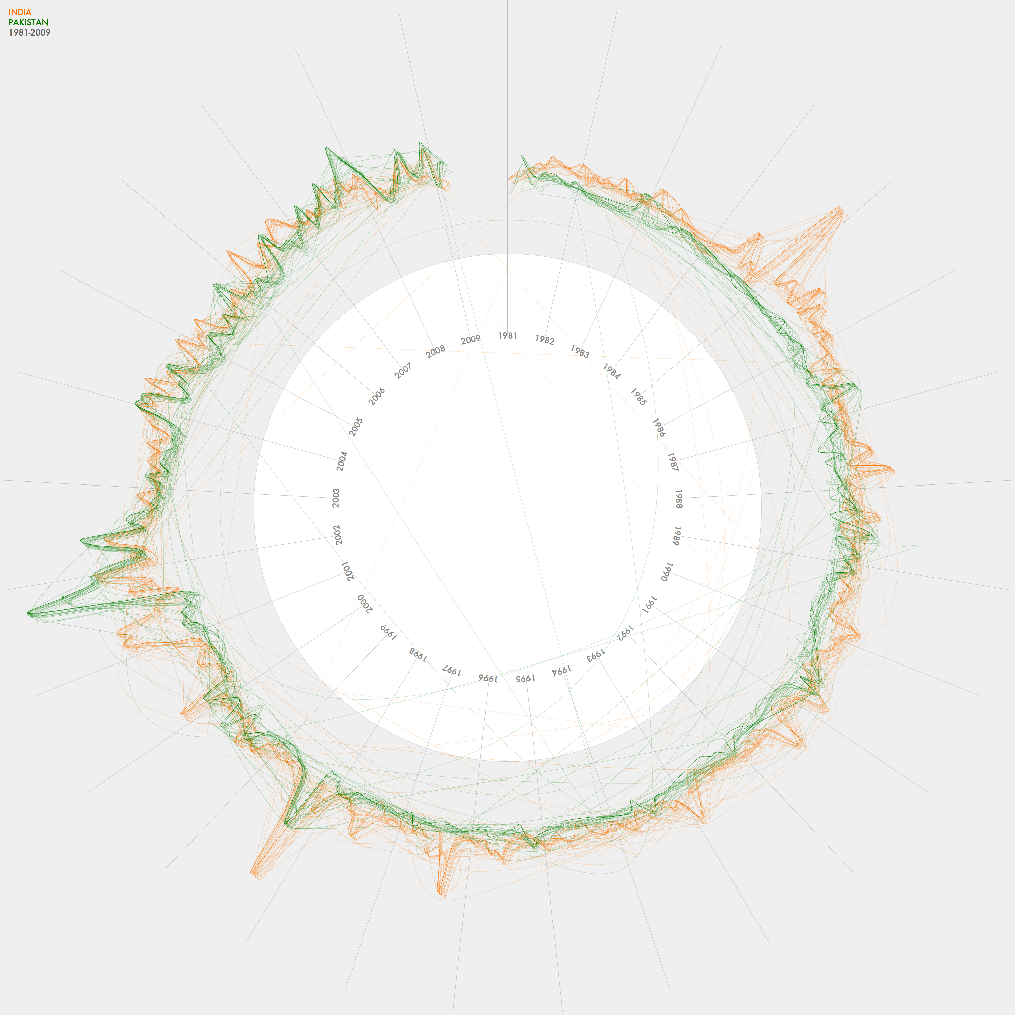
Jer Thorp
Data Artist
NYTimes Threads - India & Pakistan
This graph charts the frequency of articles mentioning India and Pakistan in the NYT between 1981 and 2009. It also indicates weighting of stories - the darkest line shows front page stories while the lighter lines indicate stories buried deeper in the paper.
For more information about this and other newspaper visualizations, visit my blog: blog.blprnt.com

Slide 19
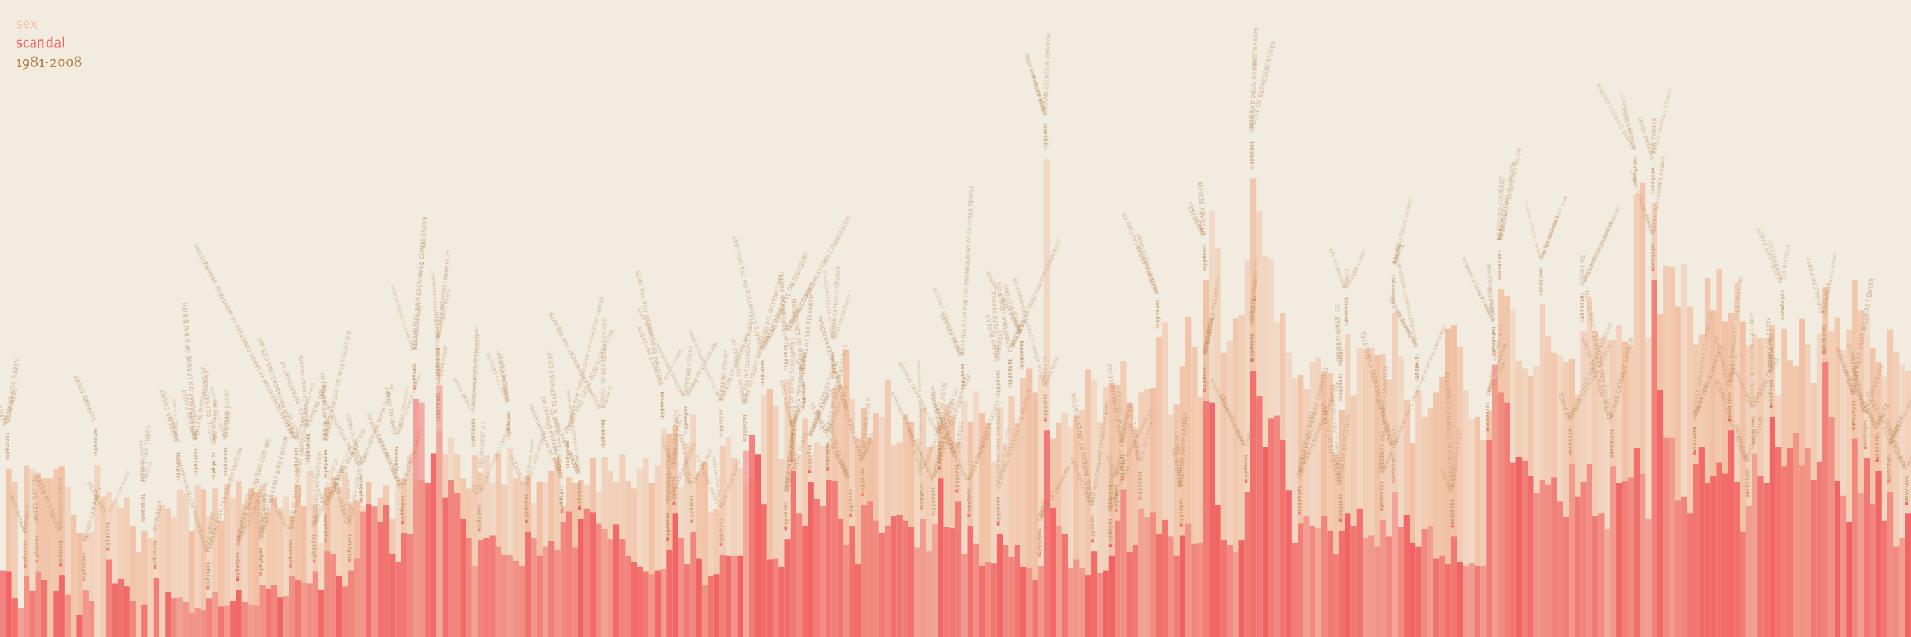
Jer Thorp
Data Artist
NYTimes: Sex & Scandal since 1981
This is a visualization of the frequency of occurrence of the words 'sex' and 'scandal' in the New York Times, since 1981.
See how many times you can count the words 'catholic church'.

Slide 20
Jer Thorp
Data Artist
NYTimes: Sex & Scandal since 1981
This is a visualization of the frequency of occurrence of the words 'sex' and 'scandal' in the New York Times, since 1981.
See how many times you can count the words 'catholic church'.

Slide 21

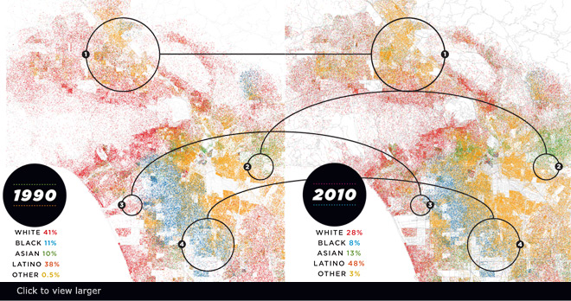
Race in LA (Eric Fischer)
Nice narrative @lamag.com http://www.lamag.com/features-hidden/race-in-la-see-how-weve-grown/#0412infographic
Notes:
1. Most highly concentrated in the north San Fernando Valley, Latinos are now the region’s largest ethnic group.
2. With 47% of its population of Chinese descent, Monterey Park is the first mainland American city to have an Asian majority.
3. An empty industrial relic in 1990, Playa Vista is now one of L.A.’s most racially and ethnically diverse communities.
4. African Americans continue to leave South L.A. Compton is now 65% Latino, though there are no Latinos on the city council.
- See more at: http://www.lamag.com/features-hidden/race-in-la-see-how-weve-grown/#0412infographic

Slide 22
World travel and communications recorded on Twitter
Green is physical movement from place to place; purple is @replies from someone in one location to someone in another; combining to white where there is both.
Reported trips to Null Island excluded; all other geotags trusted. Endpoints of trips are real data; routes in between are fabricated. Brightness is logarithmic.
Data from the Twitter streaming API through September 1, 2011. Continent shapes from Natural Earth. Author: Eric Fischer https://www.flickr.com/photos/walkingsf/6635655755/in/photostream/

Slide 23
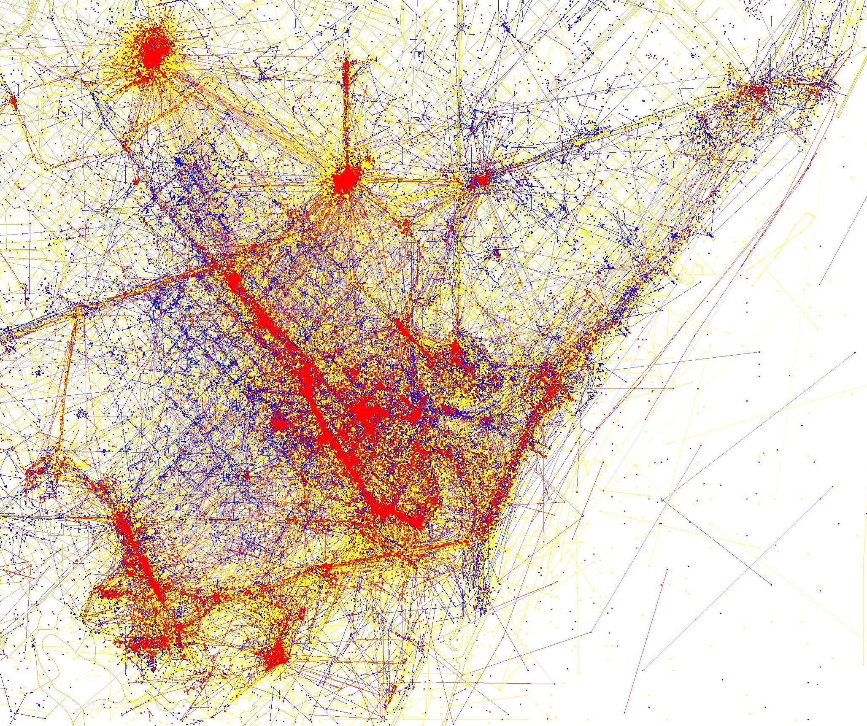
Tourist vs locals in Barcelona. Shows. Blue photos (Flickr) live in the city, red are tourists, yellow are unknown. Eric Fischer again
More details:
https://lotteharmsen.wordpress.com/tag/eric-fischer/

Slide 24
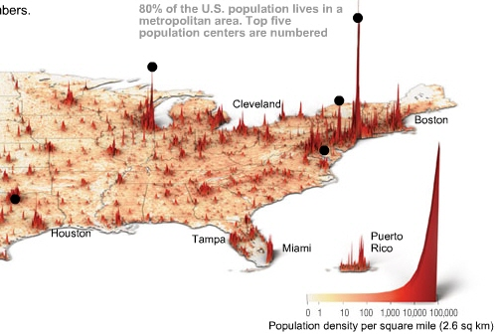
Time Magazine
http://content.time.com/time/interactive/0,31813,1549966,00.html

Slide 25
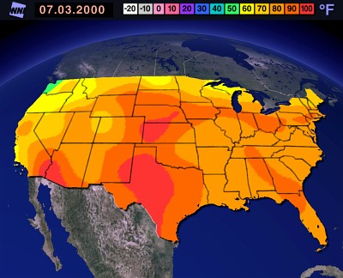
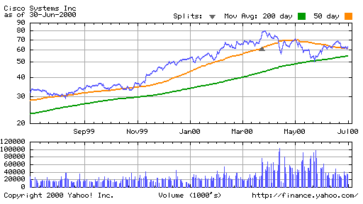
Small Data?

Slide 26
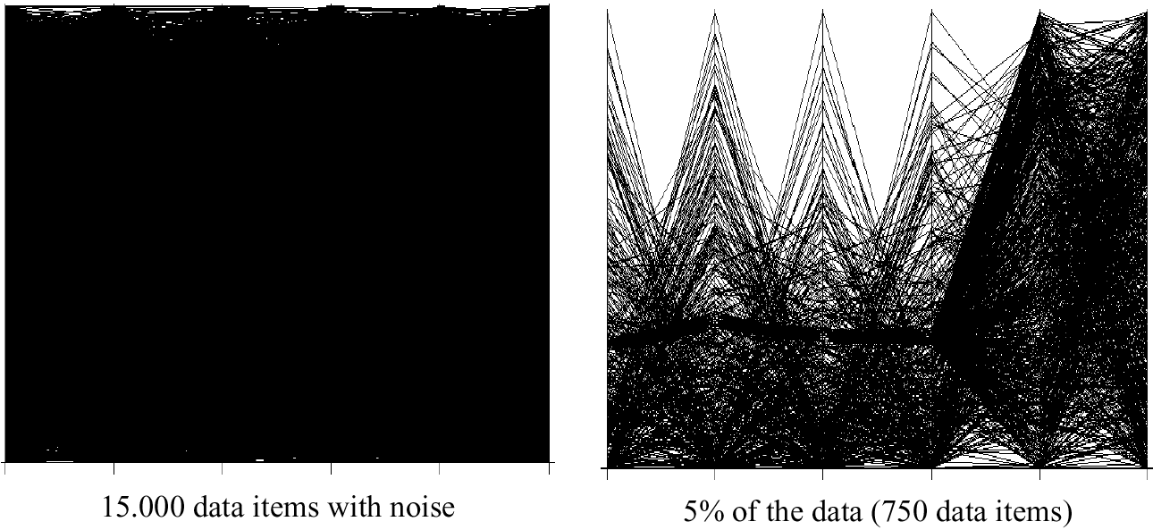
Visualization Techniques for Big Data

Slide 27
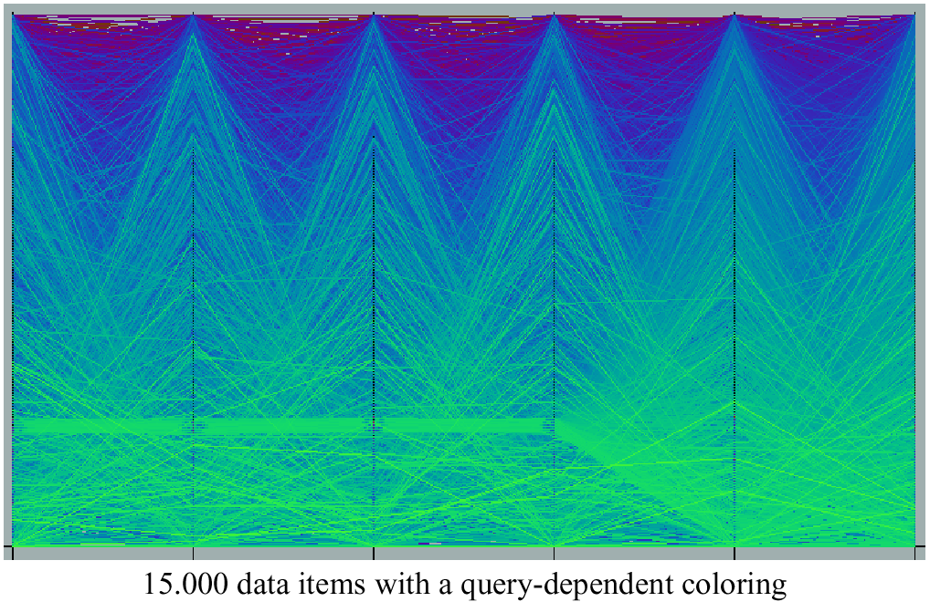
Query Dependent Coloring

Slide 28
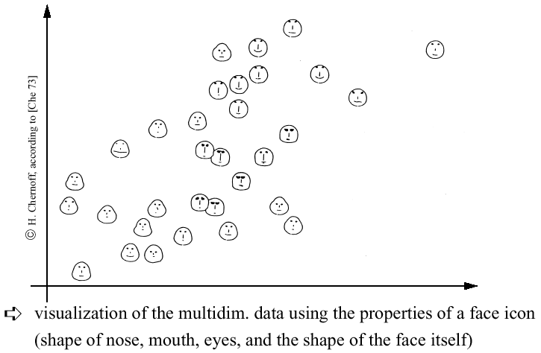
Chernoff-faces

Slide 29
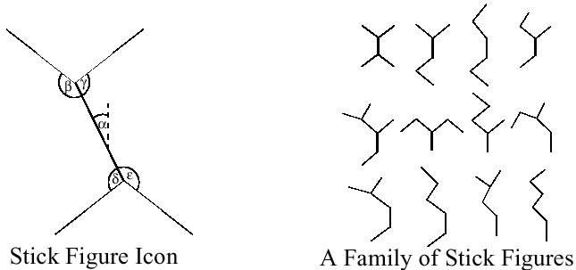
Stick Figures
Notes:
Visualization of the multidimensional data using stick figure icons
Two attributes of the data are mapped to the display axes and the remaining at-tributes are mapped to the angle and/or length of the limbs
Texture patterns in the visualization show certain data characteristics

Slide 30

Stick Figures

Slide 31
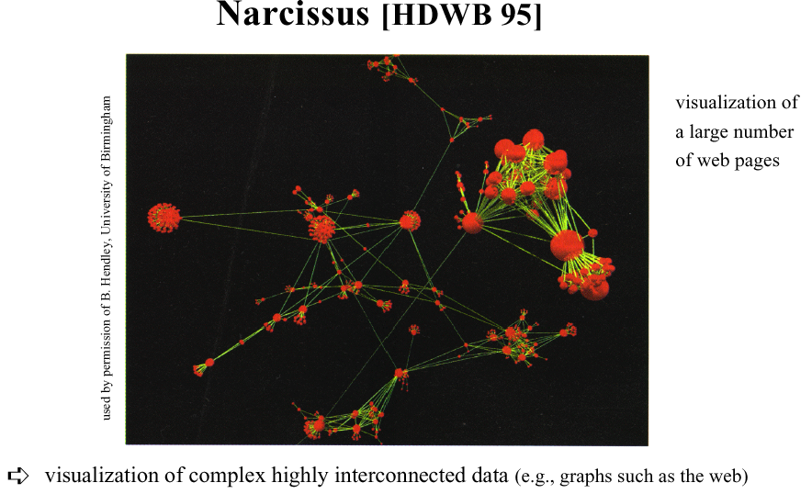
Graph-based Techniques

Slide 32
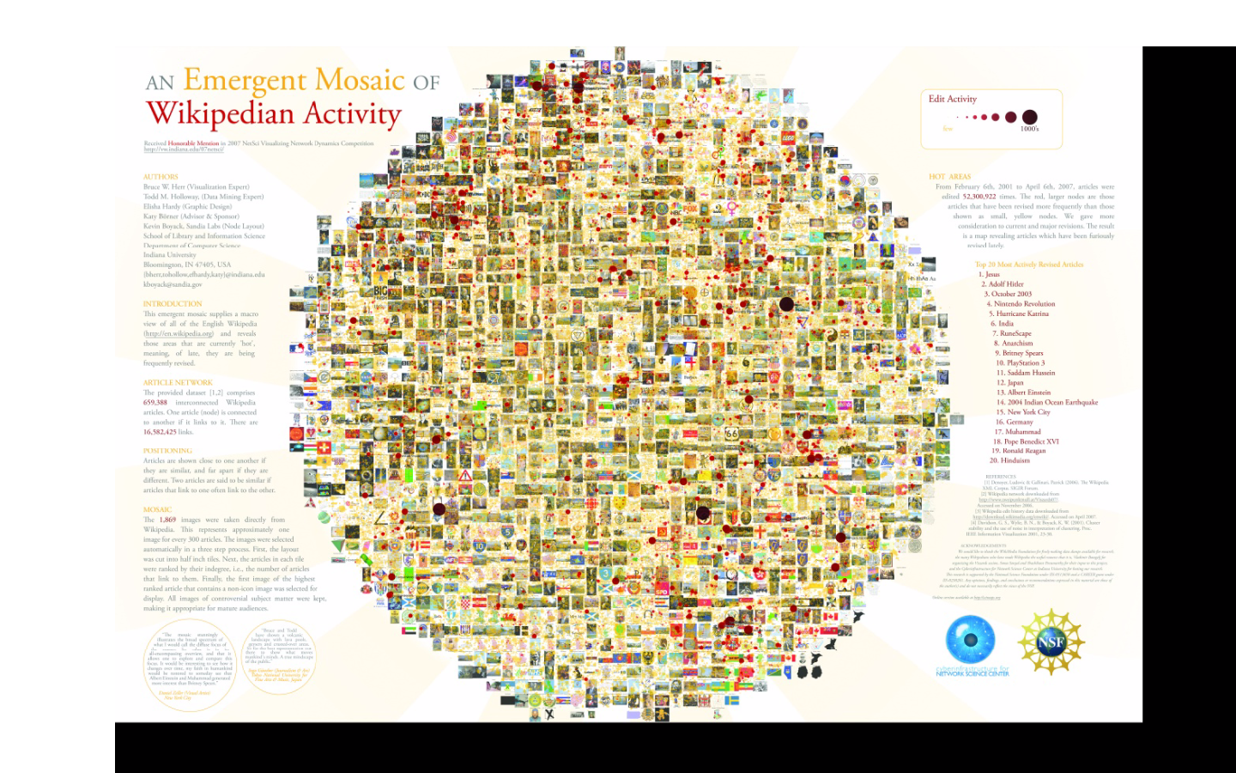
Zoomable UIs
http://gigapan.com/gigapans/4304
Notes:
he sizes of the nodes (circles, dots, whatever you want to call them), are based on a model of revision activity. So large circles indicate that an article might be controversial, or the subject of lots of vandalism, or just a topic whose content frequently changes.

Slide 33
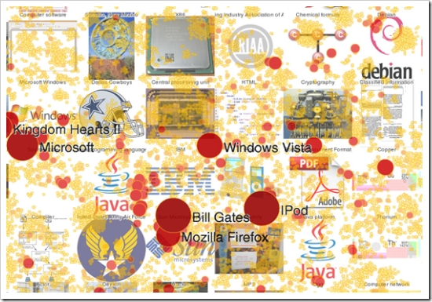
Zoomable UIs
http://gigapan.com/gigapans/4304
Notes:
he sizes of the nodes (circles, dots, whatever you want to call them), are based on a model of revision activity. So large circles indicate that an article might be controversial, or the subject of lots of vandalism, or just a topic whose content frequently changes.

Slide 34
Distortion Techniques
Basic Idea: Distortion of the image to allow a visualization of larger amounts of data
An alternative to zoomable Uis (or complement)

Slide 35
Distortion Techniques
Basic Idea: Distortion of the image to allow a visualization of larger amounts of data
Simple:
Perspective Wall [MRC91]
Bifocal Displays [SA 82]
TableLens [RC94]
Graph. Fisheye Views [Fur 86, SB94]
Hyperbolic Repr. [LR94, LRP95]
Complex:
Hyperbolic Repr. [LR94, LRP95]
3D-Hyperbolic Repr. [MB95]
Hyperbox [AC91]

Slide 36
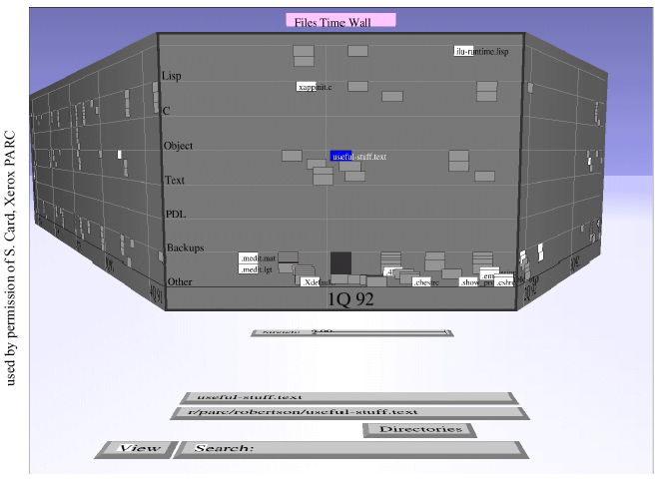
Perspective Wall
Notes:
Presentation of the data on a perspective wall
The data outside the focal area are perspectively reduced in size
The perspective wall is a variant of the bifocal lens
Display [SA82] which horizontally compresses the sides of the workspace by direct scaling

Slide 37
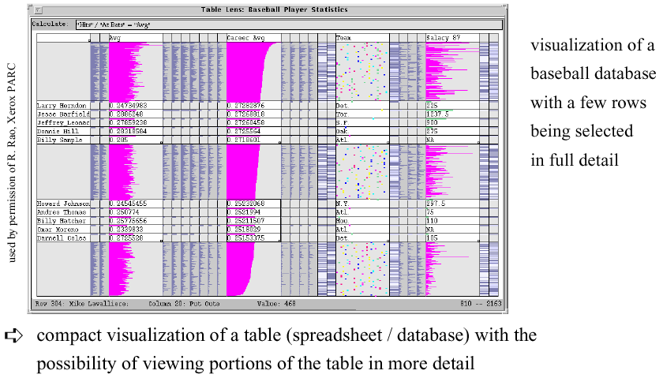
Table Lens

Slide 38
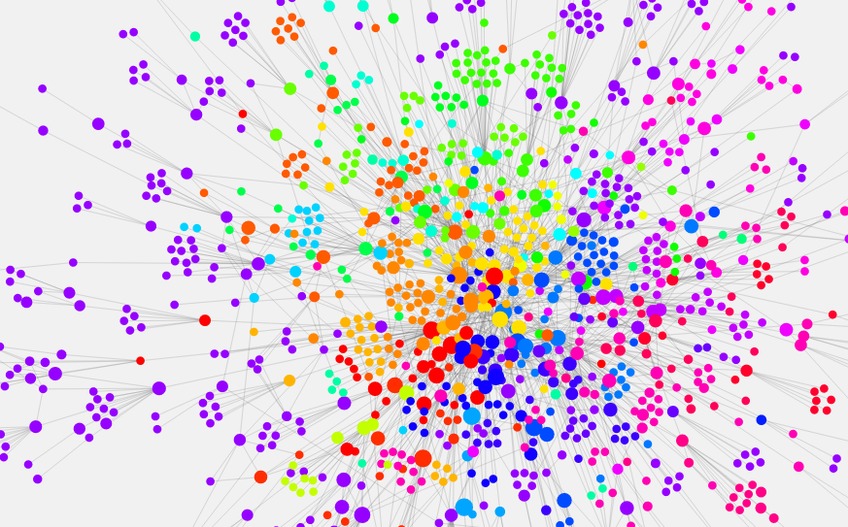
Networks of Information
http://www.designandanalytics.com/philosophers-graph/
Notes:
[a topic for byte 6]

Slide 39
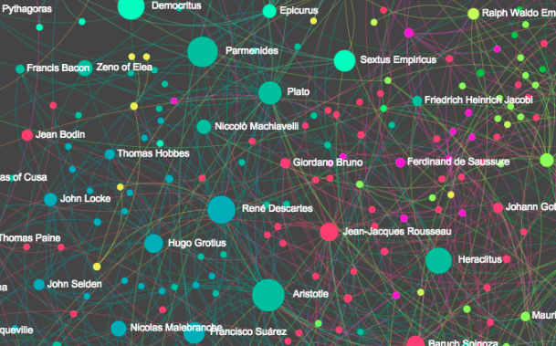
Networks of Information – with zooming
http://www.designandanalytics.com/philosophers-gephi/

Slide 40
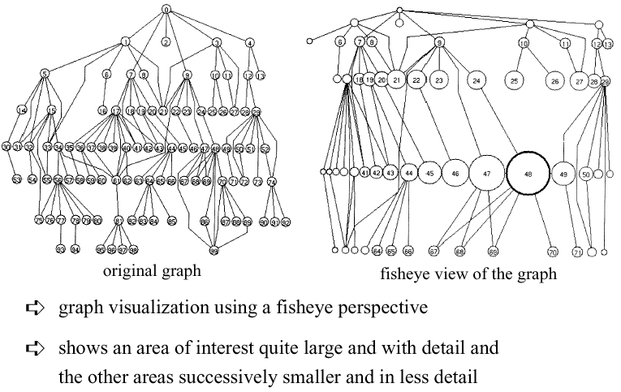
Fisheye View

Slide 41
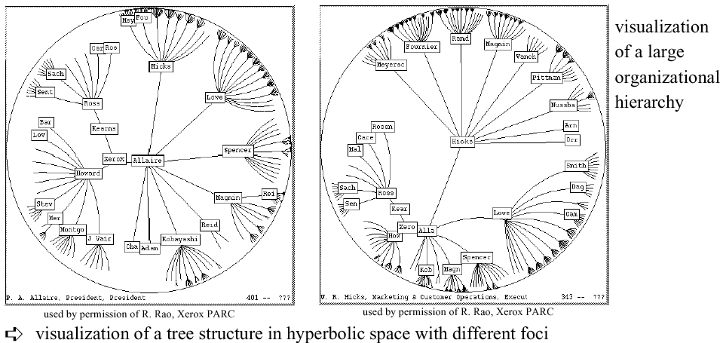
Hyperbolic Tree

Slide 42
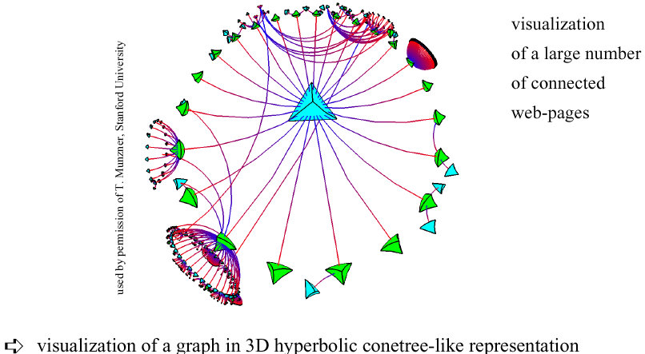
3D Hyperbolic Representation

Slide 43

Magic Lenses/Moveable Filter
interactive selection using lens-like tools which selectively filter the data in the considered areas
multiple lenses/moveable filters can be used for a multi-level filtering (allowing complex conditions)

Slide 44
TreeMap (Johnson & Shneiderman ’91)
The TreeMap Idea:
Show a hierarchy as a 2D layout
Fill up the space with rectangles representing objects
Size on screen indicates relative size of underlying objects.

Slide 45
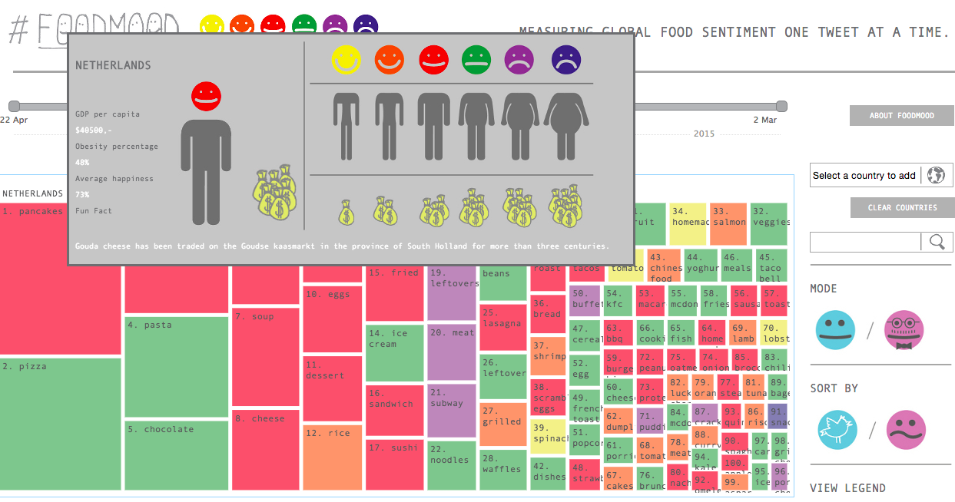
Treemap
http://foodmood.in/
Notes:
XX UPDATE – bad example, doesn’t seem to have any hierarchy!

Slide 46
Successful Application of Treemaps
Think about the use (analysis vs comunication)
Break into meaningful groups
Fix these into a useful aspect ratio
Use visual properties properly
Use color to distinguish meaningfully
Use only two colors:
Can then distinguish one thing from another
When exact numbers aren’t very important
Provide excellent interactivity
Access to the real data
Makes it into a useful tool

Slide 47
Further Reading
Big Data Issues in Climate Science
http://online.liebertpub.com/doi/full/10.1089/big.2014.0026
“Every dataset has a story, and understanding it can guide the choice of suitable analyses; some have labeled this data understanding as data empathy.”
Big Data and Health
http://online.liebertpub.com/doi/full/10.1089/big.2013.0029
“Big Data, Justice & Power… it is dangerous to think that big data, including that large-scale data can be made anonymous, are inherently objective and include tacit or explicit consent or an opt-out function.”
Notes:
‘data empathy

Slide 48
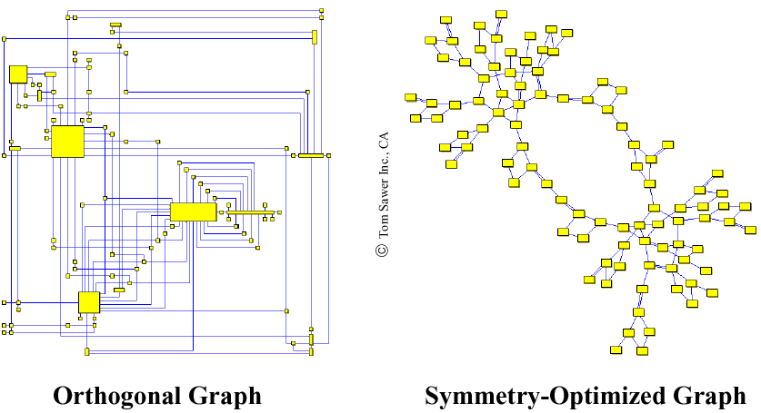
2D Graph Examples

Slide 49
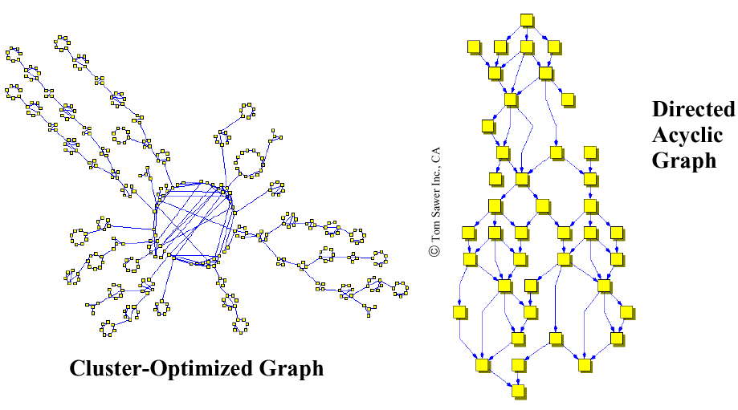
2D Graph Examples
Notes:
With Distortion
Properties of 2D-Graph Drawings
planarity (no line crossings)
orthogonality (only orthogonal lines)
grid property (coordinates of vertices are integers)
Aesthetics Properties (Optimization Goals)
minimal number of line crossings
optimal display of symmetries
optimal display of clusters
minimal number of bends in polyline graphs
uniform distribution of vertices
uniform edge lengths

Slide 50
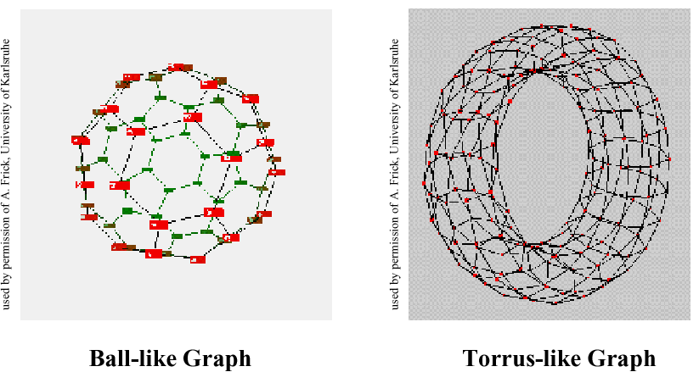
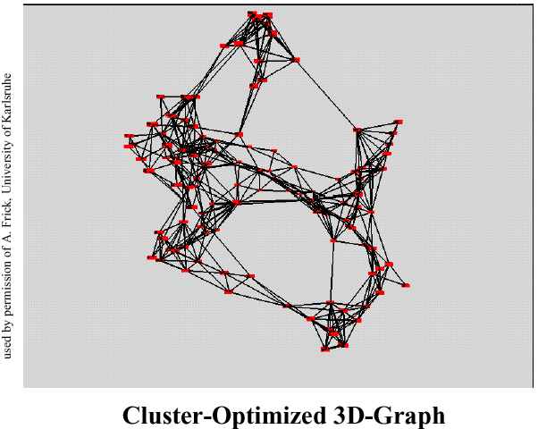
3D-Graph Drawing

Slide 51
Summary
Make use of every pixel
Use color and location to break the data up and allow the viewer to easily filter
Give a sense of things and use zooming for detail
Add a dimension such as time or height for a key variable
Allow exploration through distortion, filtering, highlighting, and linking
Exploit hierarchy and connectivity

